Slide 1

Amazon-Prime Video Recommendation System G SAI SRIKAR (sgandhe@iu.edu) SONAL (sona@iu.edu)

Slide 2

Introduction
In recent years, recommendation systems have evolved as a solution to the problem of information overload by presenting users with the most appropriate products from a vast amount of data.
The goal of online collaborative movie ideas for media products is to assist customers in obtaining their favorite films by pinpointing precisely identical people or films from their prior shared searches.
The lack of data makes neighbor choosing more difficult with the rapid development of movies and consumers.

Slide 3

Problem Statement:
This study demonstrates the capability of ML models to recommend the user with the top 5 recommendations when the user starts searching for a particular movie or TV-show with respective to it’s genre, description, cast, director, etc.
In particular, four standards models, such as KNN, Gaussian Naïve Bayes , Complement Naive Bayes, and Bernoulli Naive Bayes have been used in this study.

Slide 4
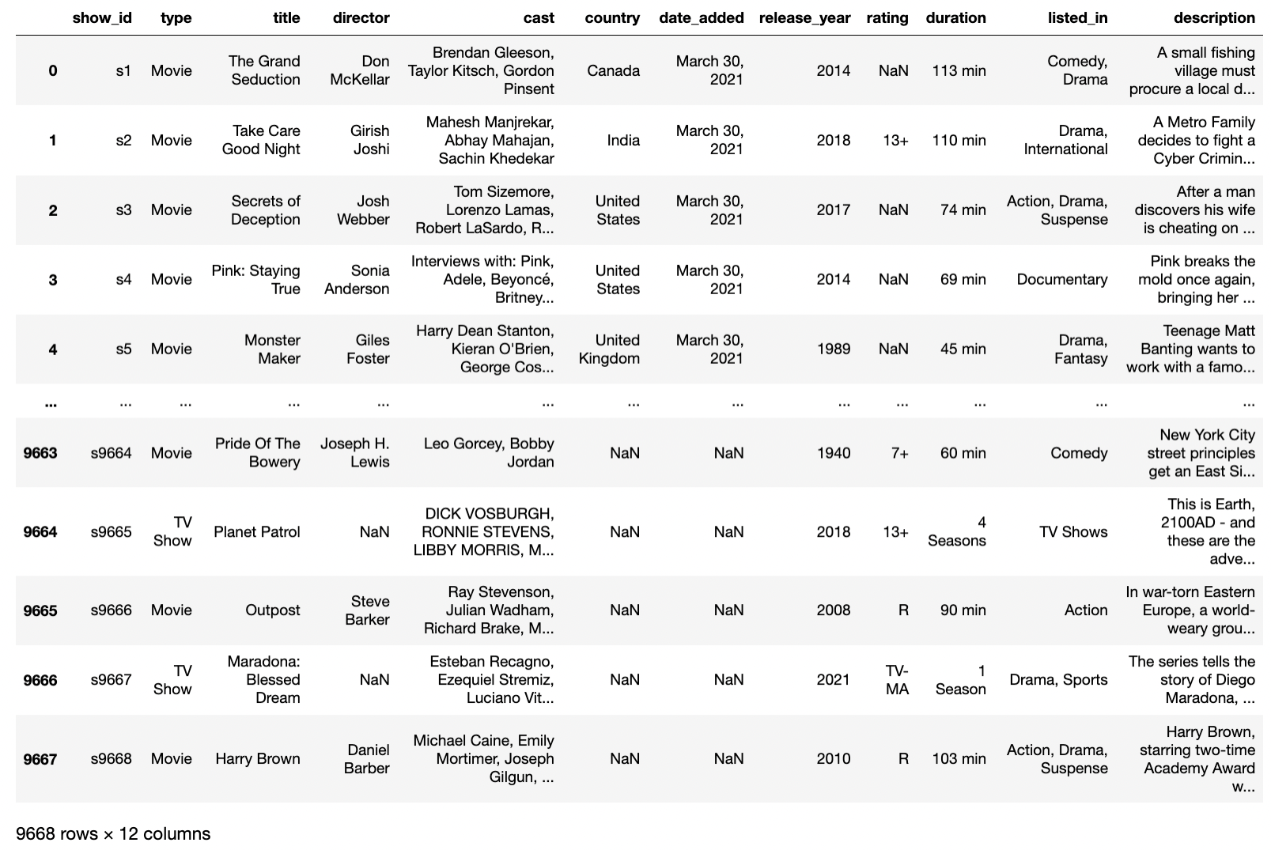
Dataset
The dataset has been taken from Kaggle. It consists of the list of all shows available on Amazon Prime. This data was acquired in May 2022 containing all the data available in the United States.

Slide 5
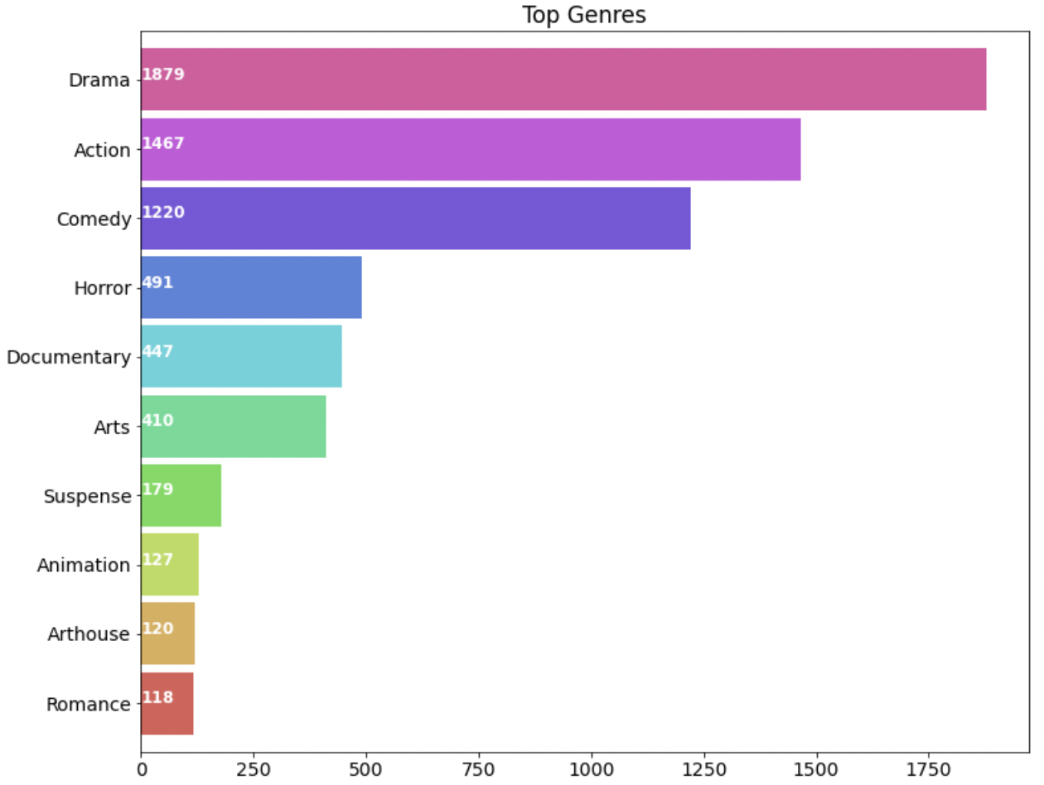
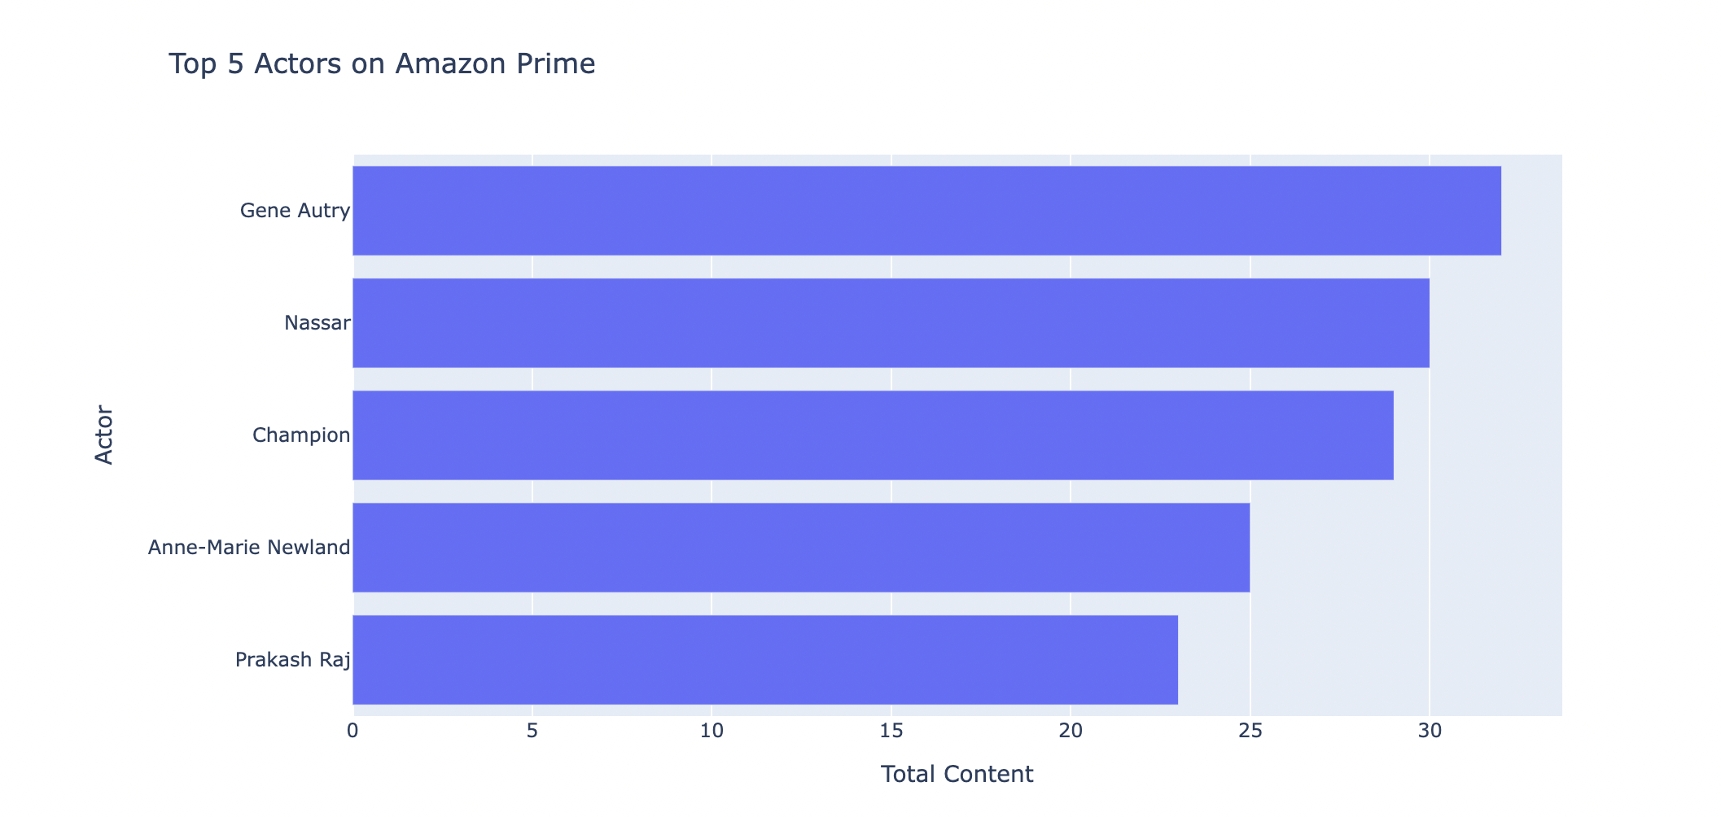
Data Visualization

Slide 6
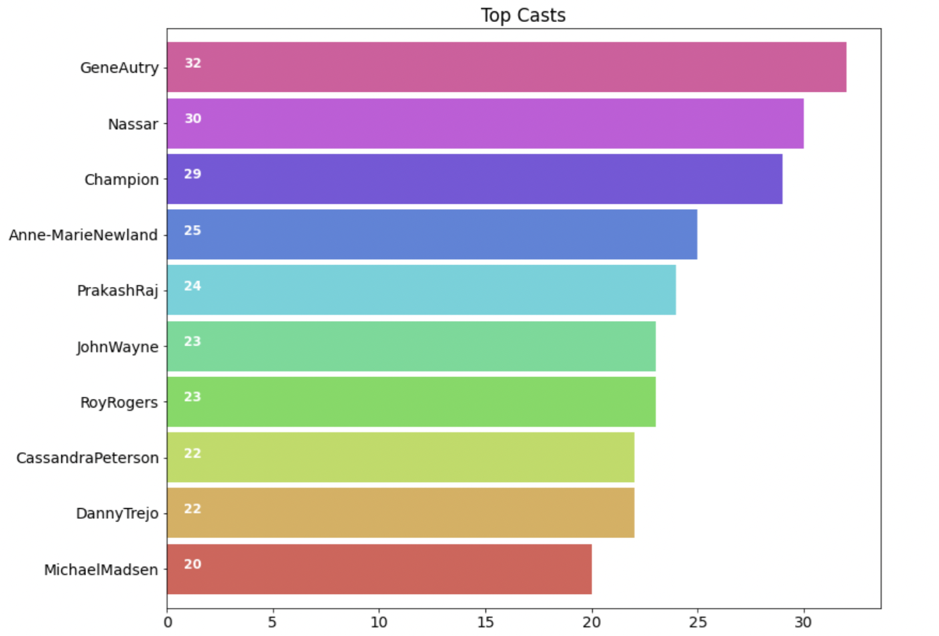
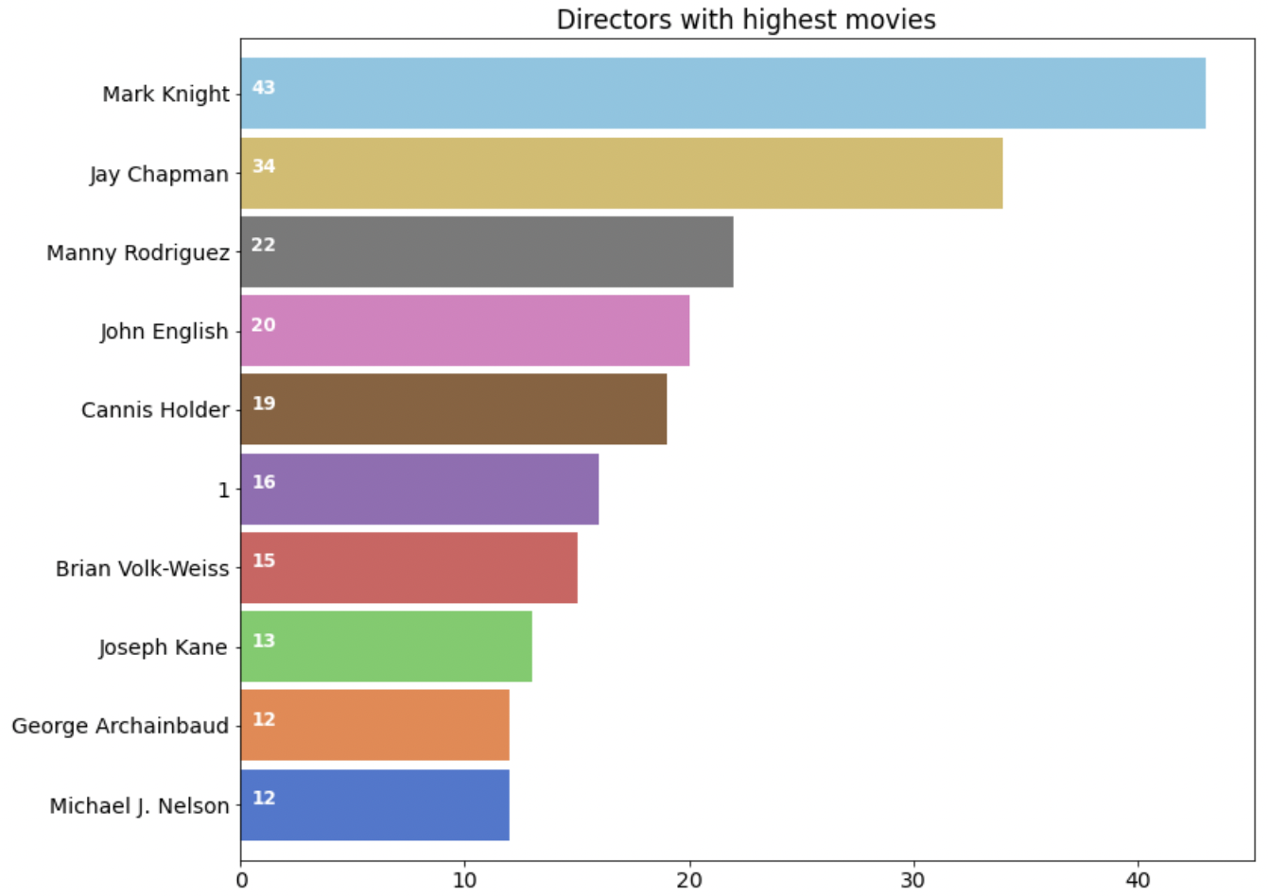
Data Visualization

Slide 7
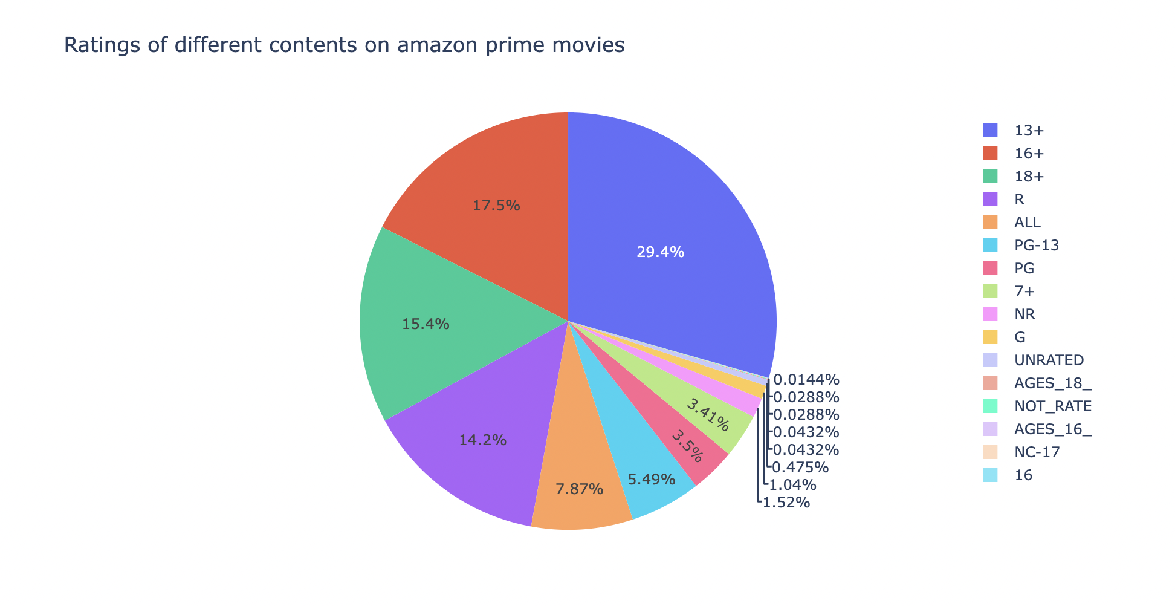
Data Visualization
.

Slide 8

Methodology
We propose building the system on collaborative and content-based filtering technique for recommendation system.
In our proposed methodology, there are four main components that are preprocessing, feature extraction, model selection and accuracy metrics.

Slide 9

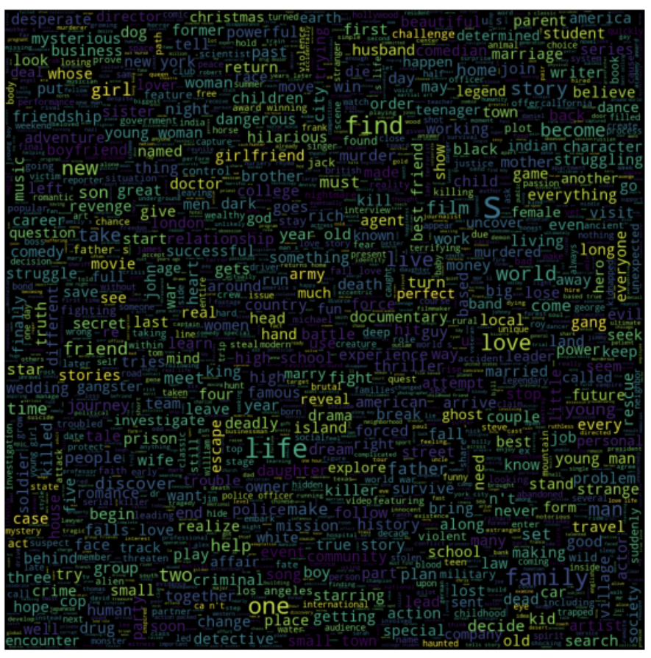
Data Pre-processing
Removed null values present in the dataset for the attributes country, date added, rating by using mode values of that specific column.
Removed stop words

Slide 10

Data Wrangling
Tokenization:- It is the process of breaking a stream of text up into words, symbols and other meaningful elements called “tokens”. It is done so that we can look at the tokens as individual components that form a tweet.
Stop Word Removal:- Stop words are a class of some extremely common words which hold no additional information when used in a text and are thus claimed to be useless. Examples include “a”,“an”, “the”,“he”, “she”, “by”, “on”, etc.

Slide 11
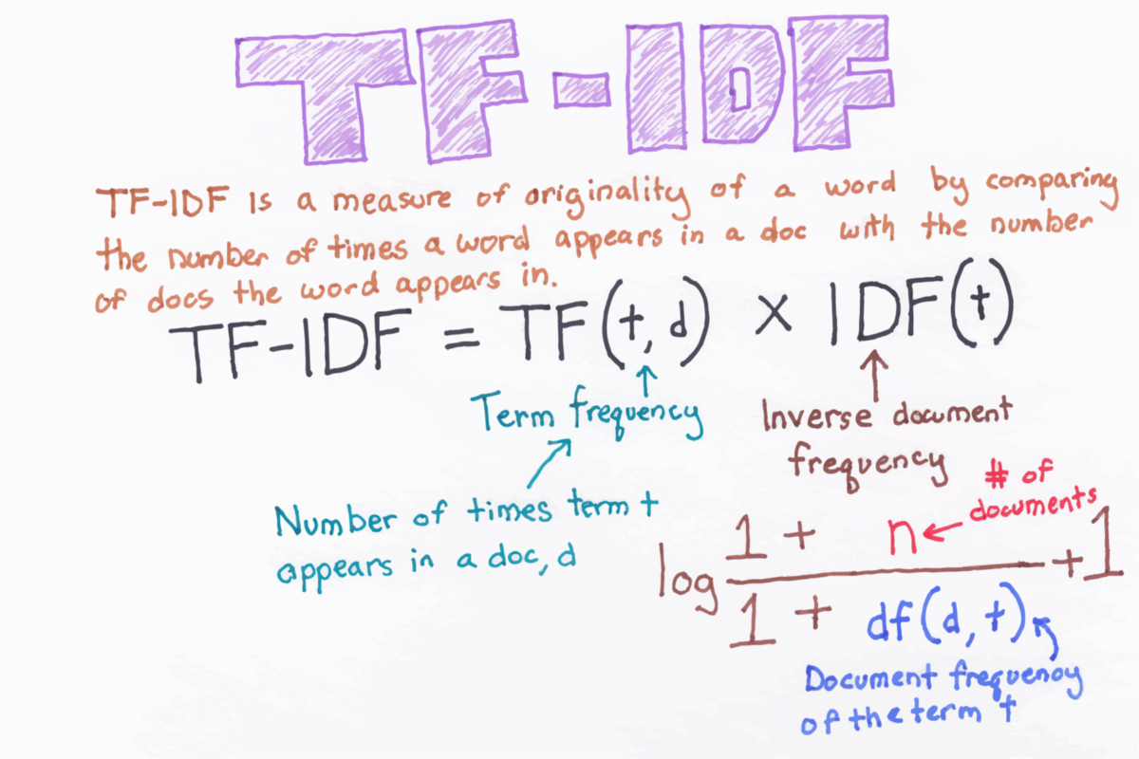
Data Wrangling
TF-IDF: A statistical measure that examines how relevant a word is to a document in a collection of documents is TF-IDF (term frequency-inverse document frequency). It was initially designed for document search and retrieval. However, it has also been used in recommendation systems and machine learning models over the years.
Count Vectorizer: It is used to convert a given text into a vector based on the frequency (count) of each word in the full text. This is useful when we have several such texts and want to transform each word into a vector (for using in further text analysis).

Slide 12
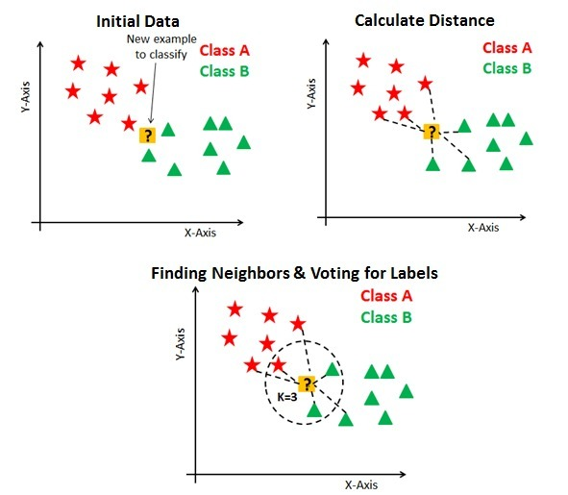
MODEL KNN:
The k-nearest neighbors’ algorithm (k-NN) is a non-parametric supervised learning approach created in 1951[1] by Evelyn Fix and Joseph Hodges and later improved by Thomas Cover. [2] Its applications include classification and regression. The input in both cases consists of the k closest training examples in a data collection.

Slide 13
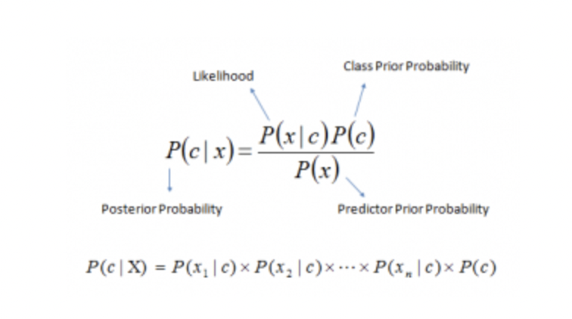
MODEL NAÏVE BAYES
Naive Bayes classifiers are a type of simple "probabilistic classifier" that uses Bayes' theorem with strong (naive) independence assumptions across the features (see Bayes classifier).
Encoding those probabilities is particularly valuable since a Naive Bayes text classifier is based on the Bayes' Theorem, which allows us to compute the conditional probability of occurrence of two events depending on the probabilities of occurrence of each individual event.

Slide 14
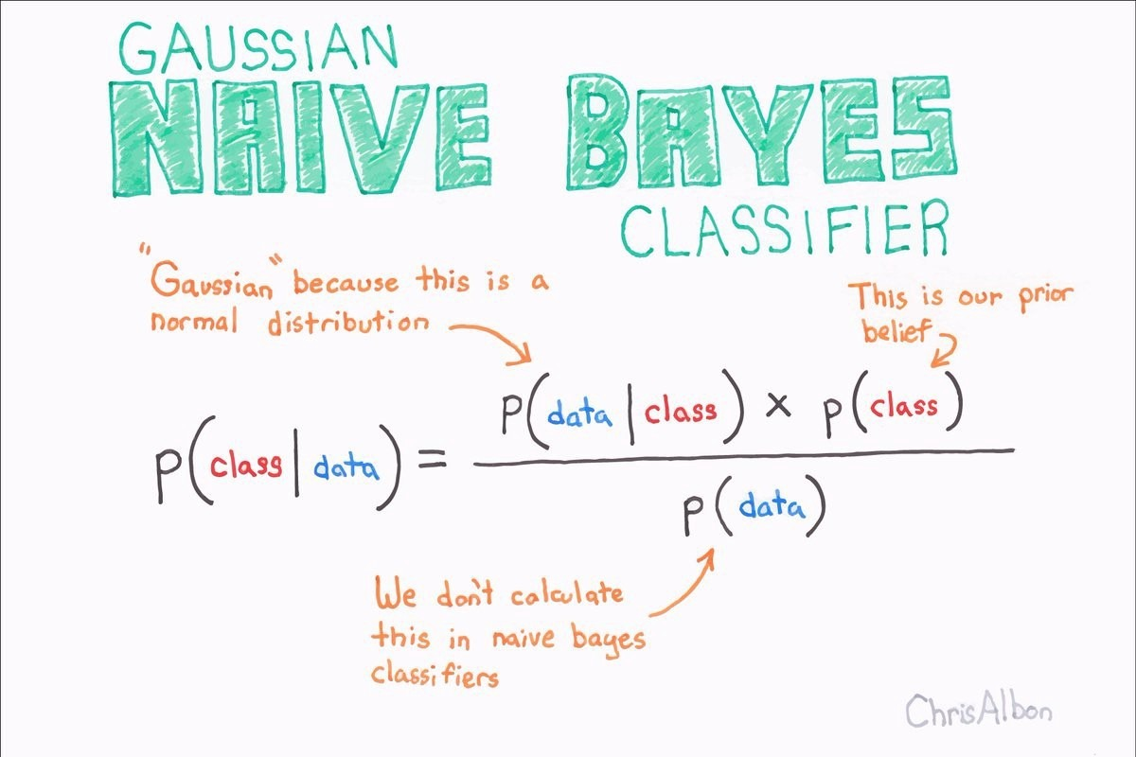
GAUSSIAN NAÏVE BAYES
In Gaussian Naive Bayes, it is assumed that each feature's continuous values are distributed according to a Gaussian distribution. The Gaussian distribution is also known as the Normal distribution. When plotted, it produces a bell-shaped curve that is symmetric about the mean of the feature values.

Slide 15
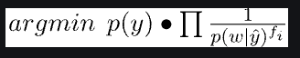
COMPLEMENT NAÏVE BAYES
Complement Naive Bayes is a modification of the Multinomial Naive Bayes method. On imbalanced datasets, Multinomial Naive Bayes does not perform well. Imbalanced datasets are those in which the number of examples of one class exceeds the number of examples of other classes. This signifies that the sample distribution is not uniform.

Slide 16
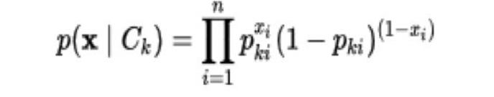
BERNOULLI NAÏVE BAYES
The features in the multivariate Bernoulli event model are independent booleans (binary variables) that describe inputs. This model, like the multinomial model, is popular for document classification problems where binary term occurrence (whether a word appears in a document or not) characteristics are employed instead of term frequencies (i.e. frequency of a word in the document).

Slide 17
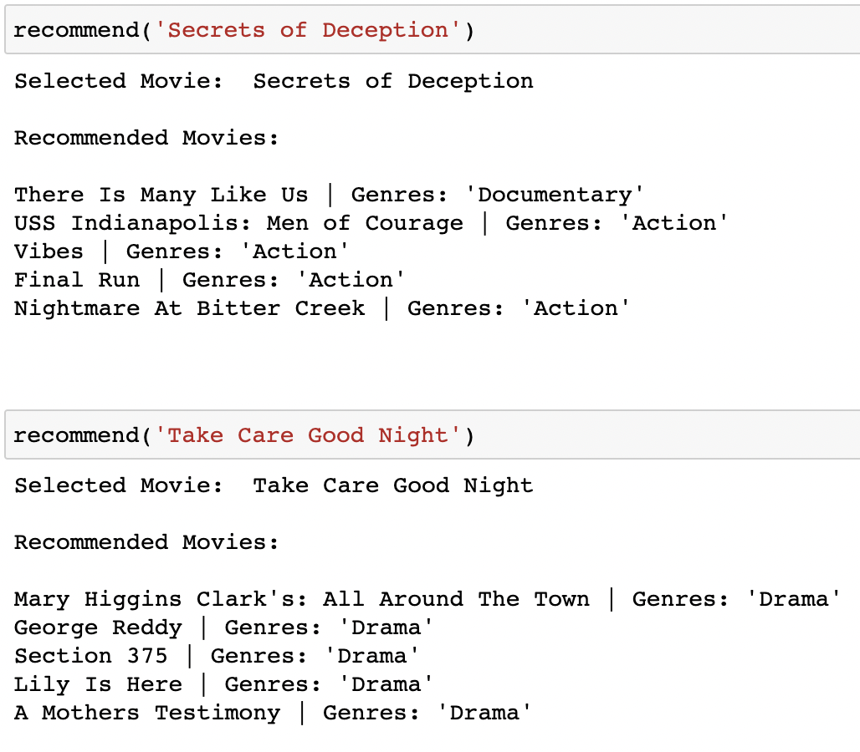
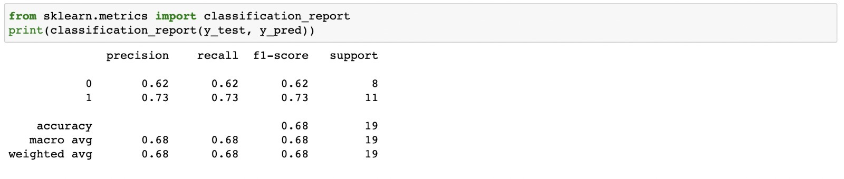
RESULTS
Recommended Movies Using KNN Algorithm

Slide 18
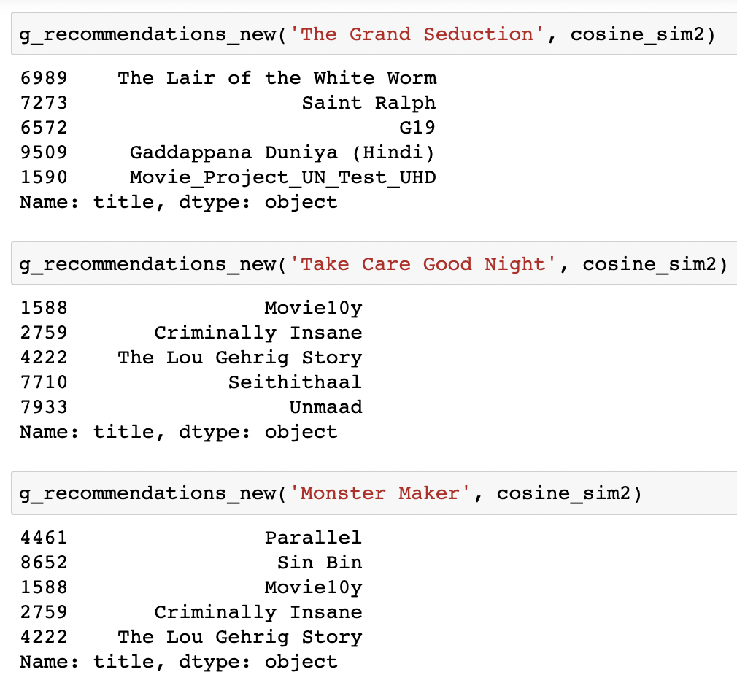
RESULTS
Recommended Movies using COUNT Vectorizer

Slide 19
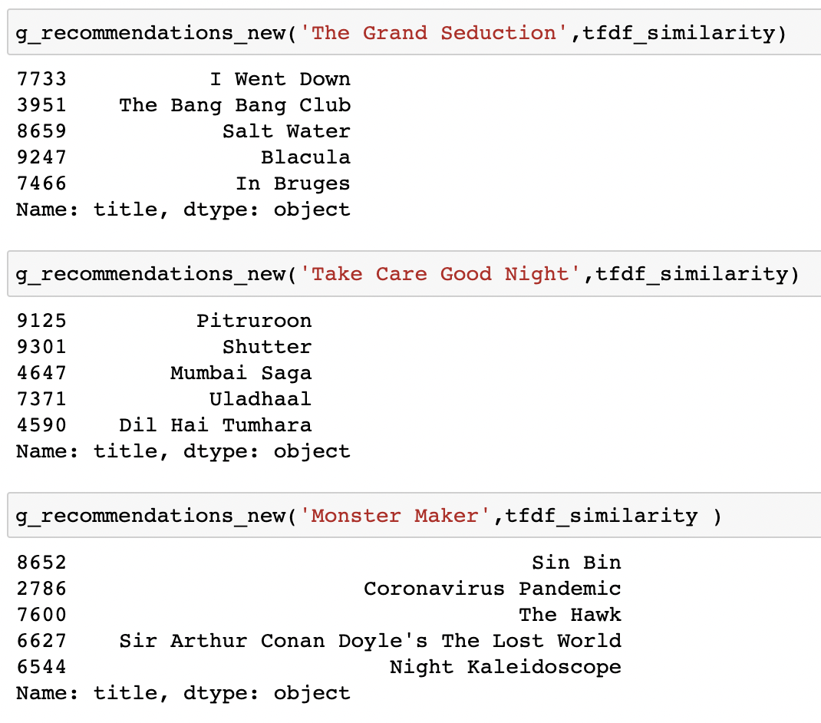
RESULTS
Recommended Movies using TFIDF Vectorizer

Slide 20
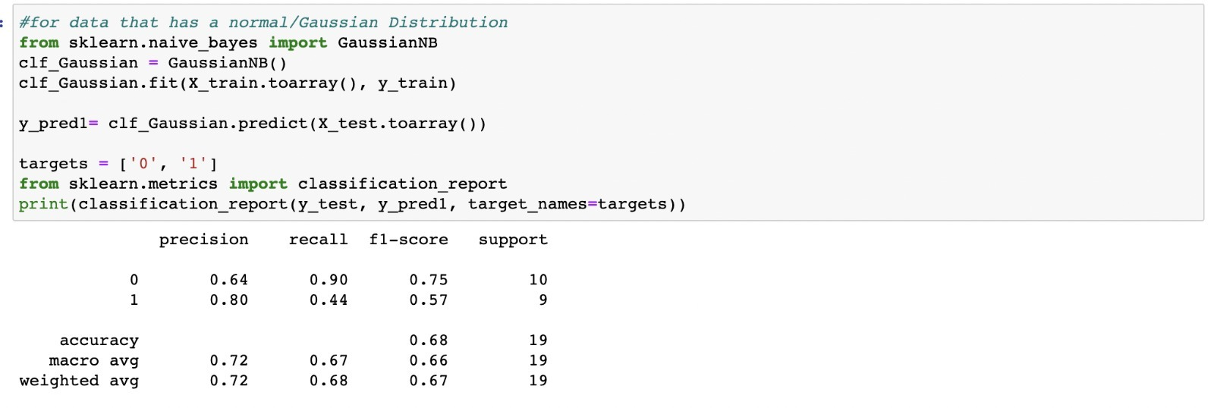
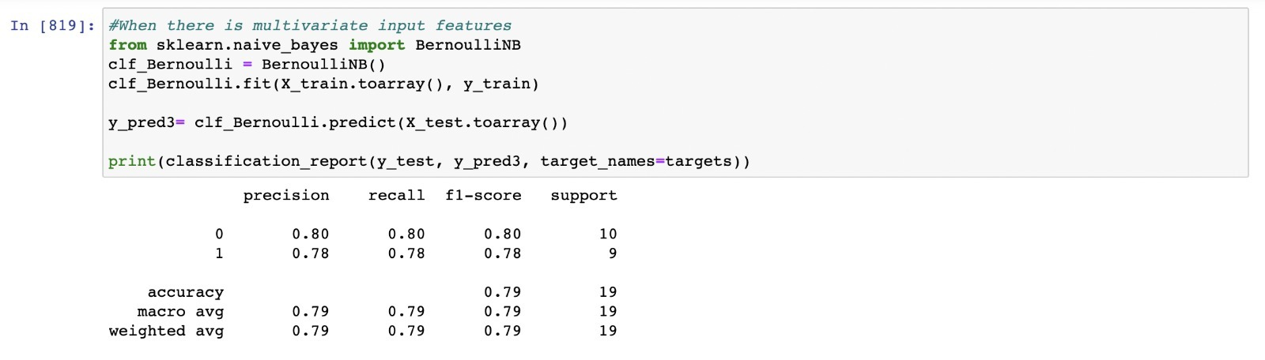
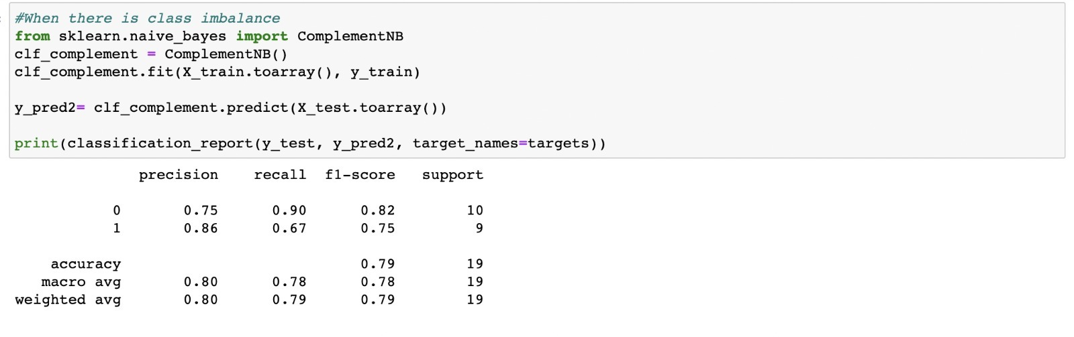
NAÏVE BAYES RESULTS

Slide 21
REFERENCES
https://towardsdatascience.com/prototyping-a-recommender-system-step-by-step-part-1-knn-item-based-collaborative-filtering-637969614ea
https://janav.wordpress.com/2013/10/27/tf-idf-and-cosine-similarity/
https://ieeexplore.ieee.org/document/9354169
https://www.enjoyalgorithms.com/blog/recommender-system-using-machine-learning

Slide 22
THANK YOU

